Slide 1
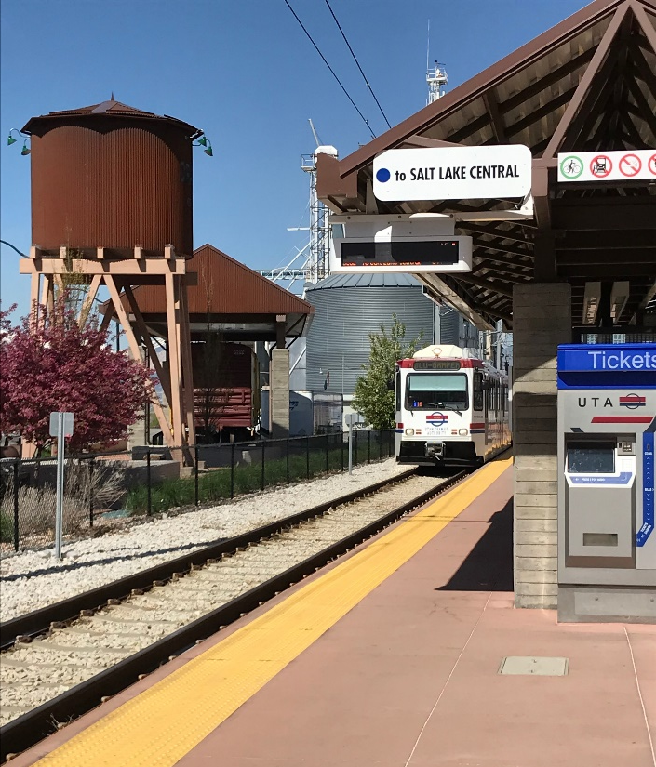
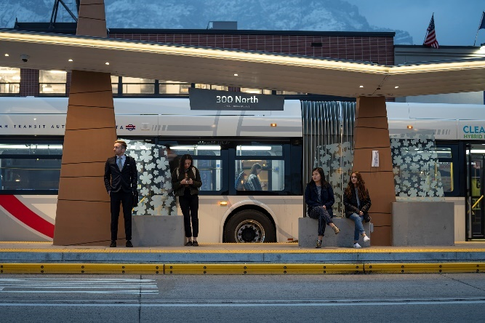
Transit Mode Overview

Slide 2
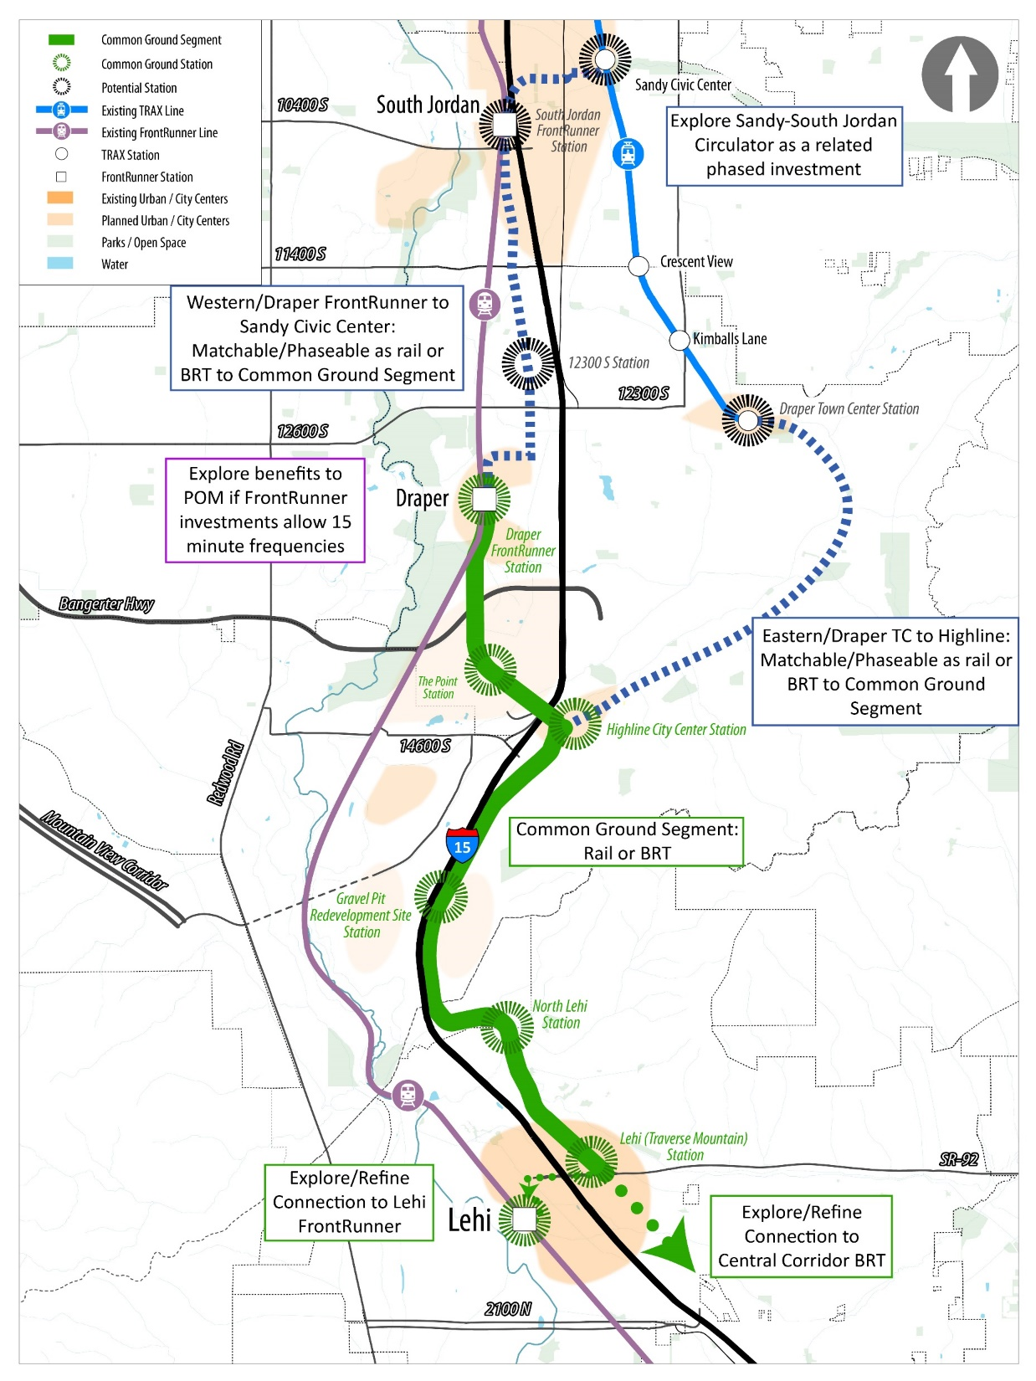
Level 2
Alternatives Overview
Recommendation from Level 1:
Common Ground Segment alignment
Two mode alternatives to consider in Level 2:
Bus Rapid Transit (BRT)
Rail

Slide 3
Mode Overview
Bus Rapid Transit and Rail similarities:
Transit service characteristics:
  Increased transit speed and reliability through use of dedicated transit lanes that are separated from traffic
  Can utilize high-capacity vehicles depending on demand
Station area characteristics:
  Amenities to enhance passenger comfort and safety
  Provide information (wayfinding and real-time travel information) and offer off-board payment
  Consistent branding and station area permanence

Slide 4
Mode Overview
Bus Rapid Transit and Rail differences:
BRT has flexibility to operate in roadway if needed; however, that decreases transit speed and reliability
Rail tends to offer more dedicated transit operations based on the separation from cars that is required for operation; however, BRT can operate at a similar standard
BRT is less costly to construct and can be implemented more quickly compared to rail

Slide 5
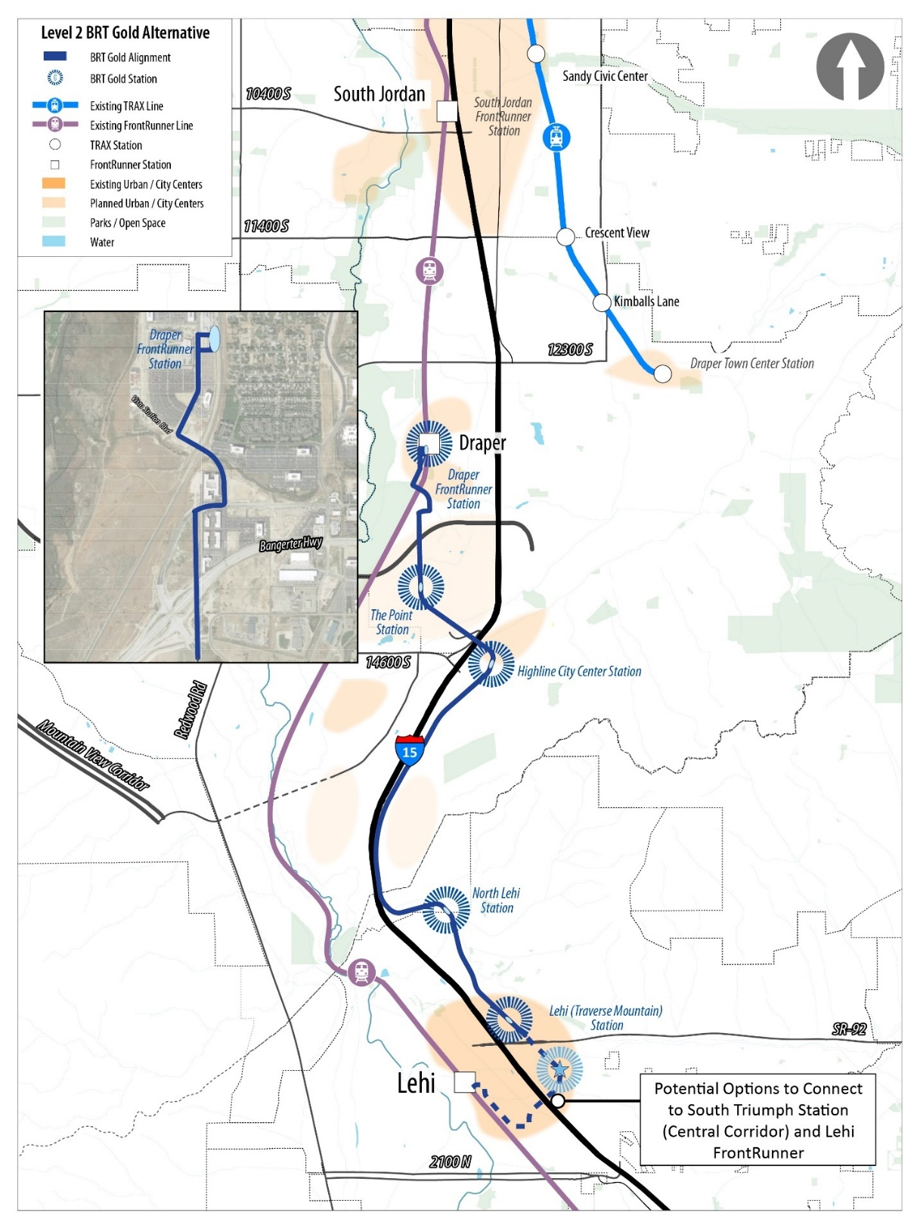
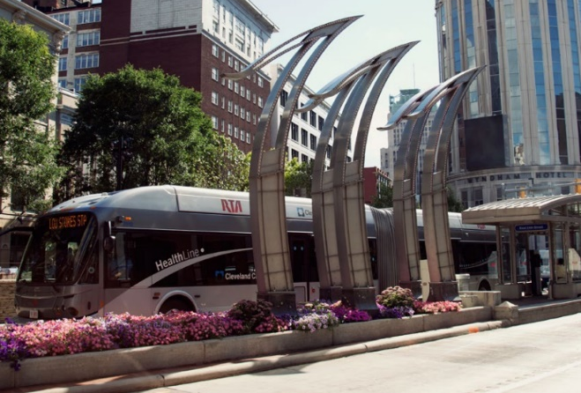
Level 2 Alternatives
-
BRT
Cleveland Healthline BRT
BRT
High-quality “gold standard”
Nearly 90% exclusive transit operations
Enhanced station area amenities
UTA UVX BRT

Slide 6
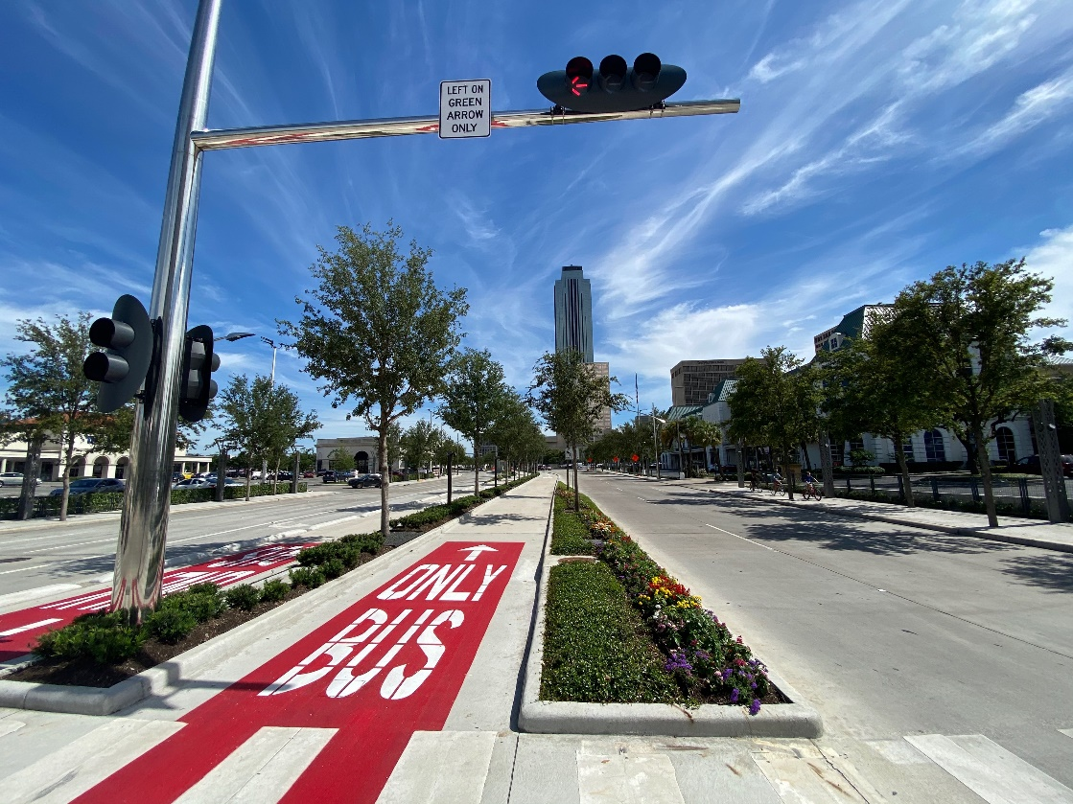
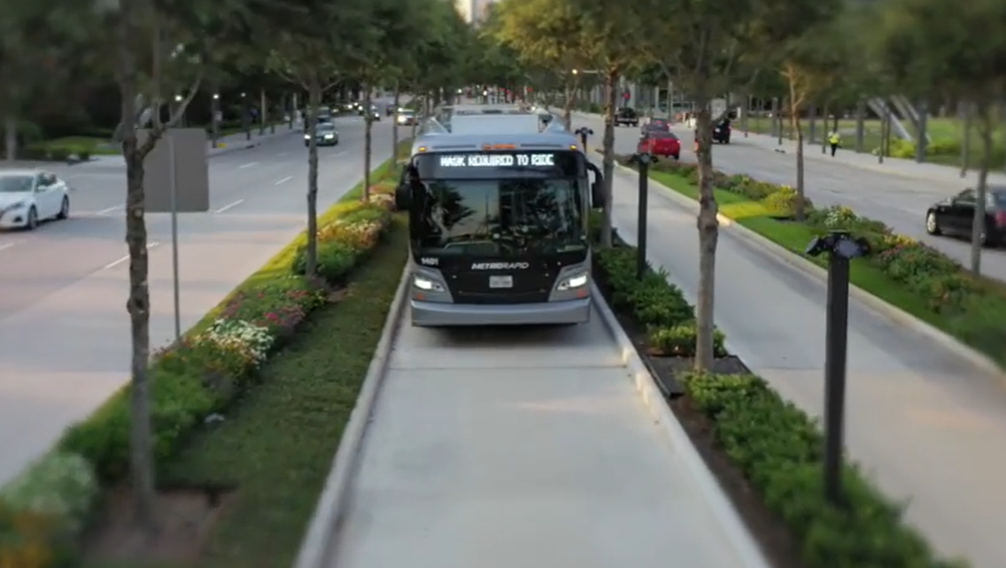
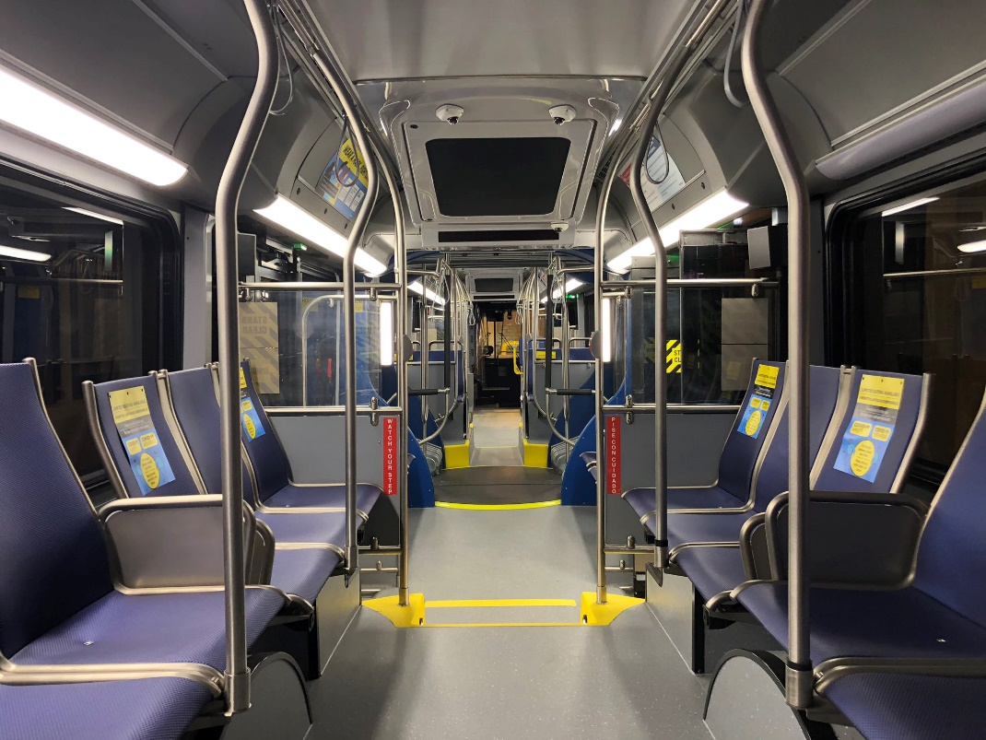
Cleveland Healthline BRT
Houston SilverLine (BRT)
Dedicated guideway
Landscaping amenities
Bus vehicles interior mimic rail look and feel

Slide 7
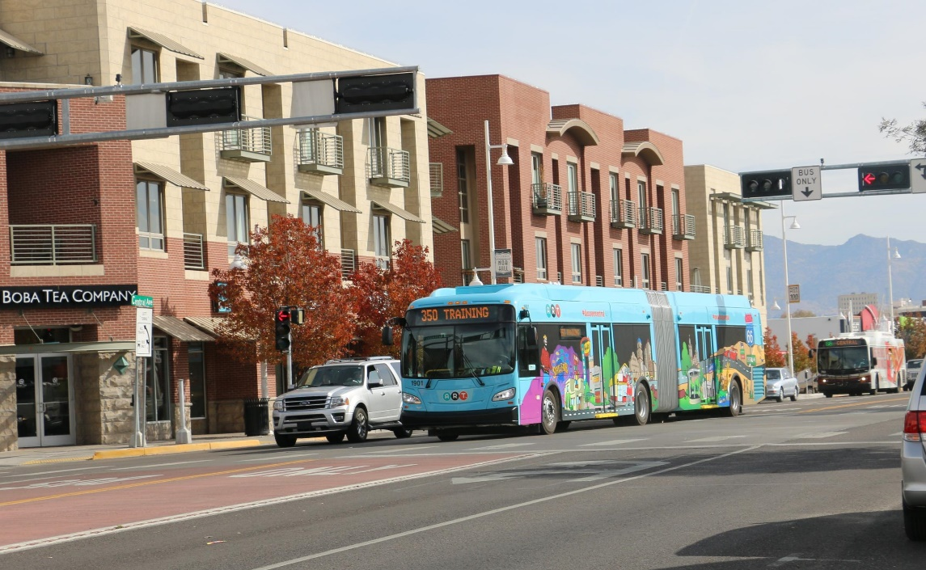
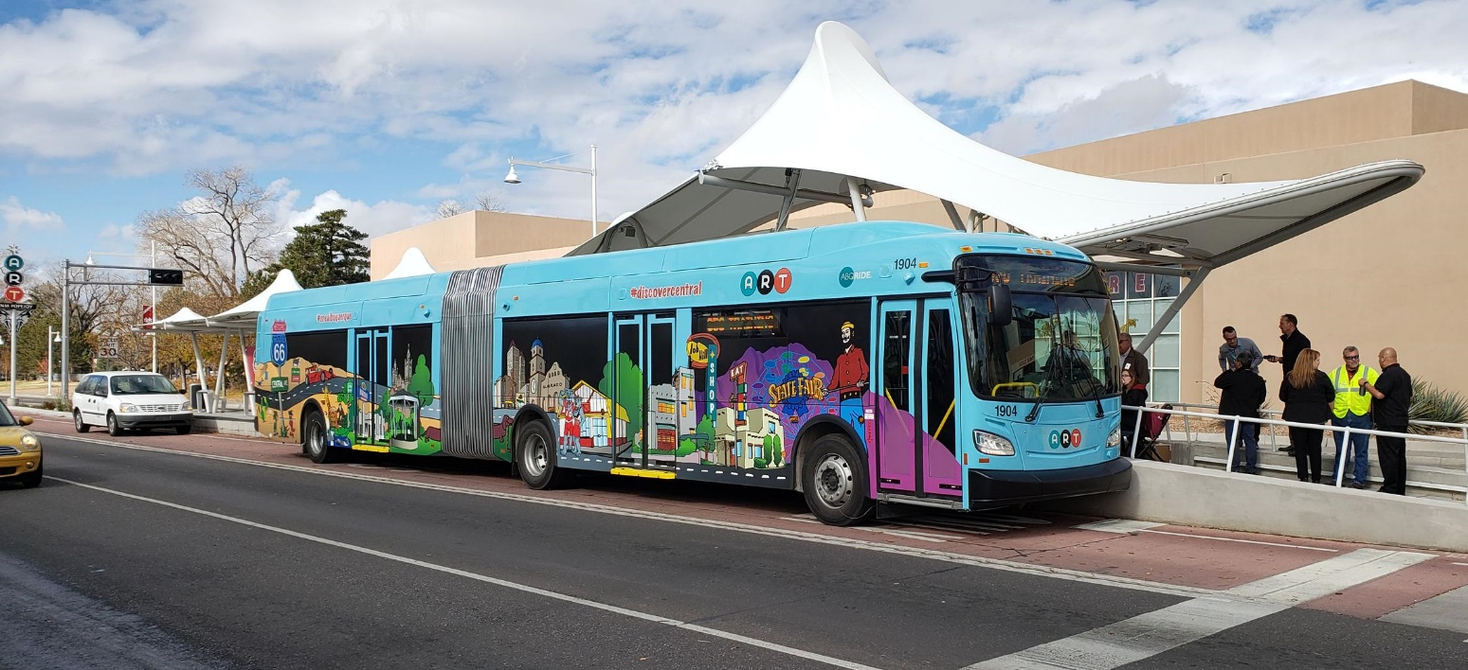
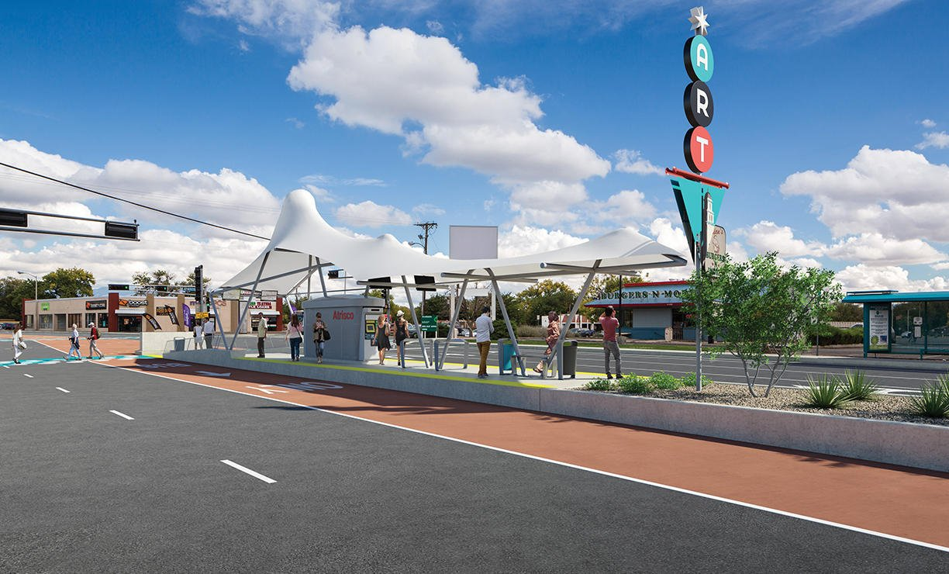
Cleveland Healthline BRT
Albuquerque ART (BRT)
Vehicle branding
Station area amenities and design
Articulated vehicle for larger capacity

Slide 8
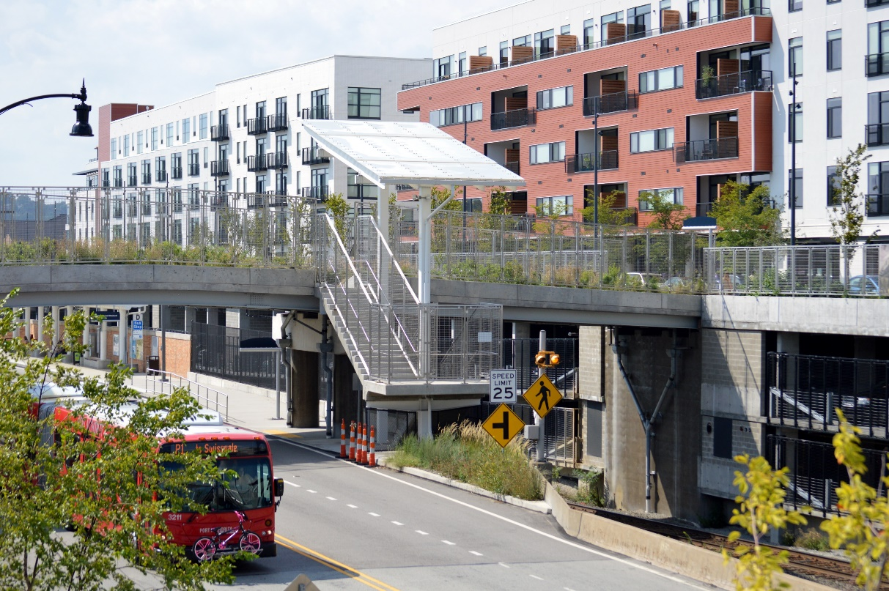
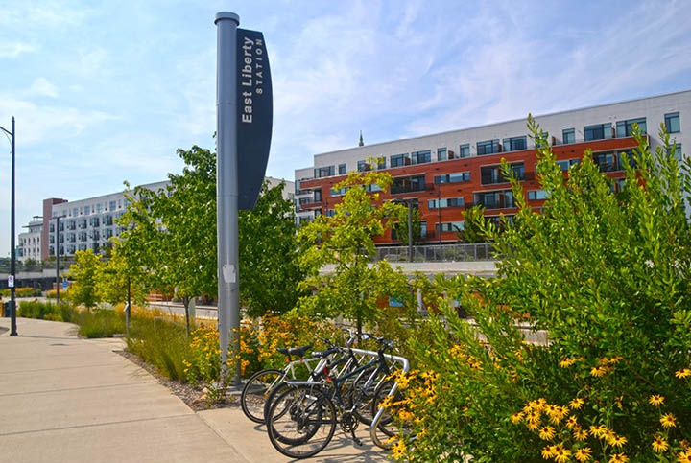
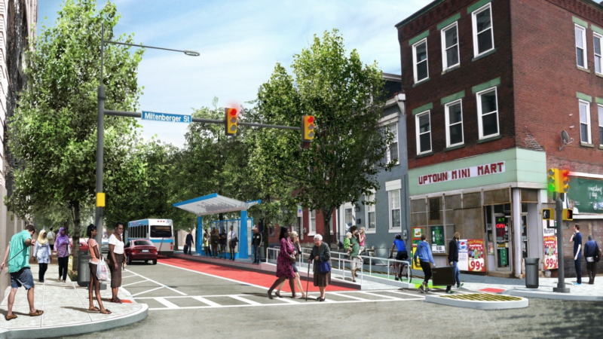
Cleveland Healthline BRT
Pittsburgh East Liberty Station (BRT)
Station integrated into the community fabric
Station area amenities

Slide 9
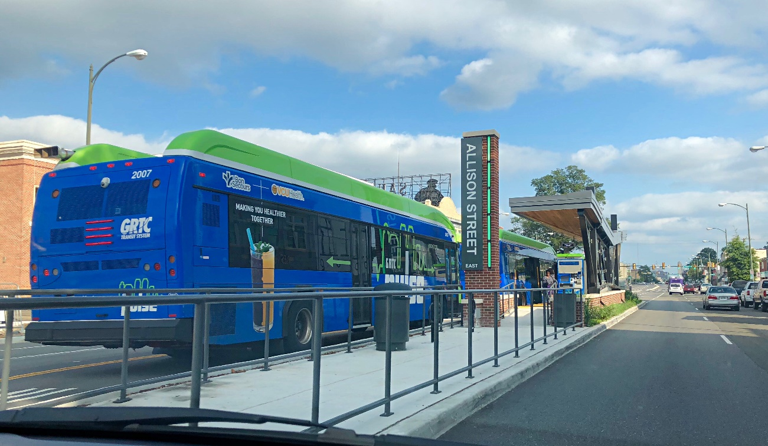
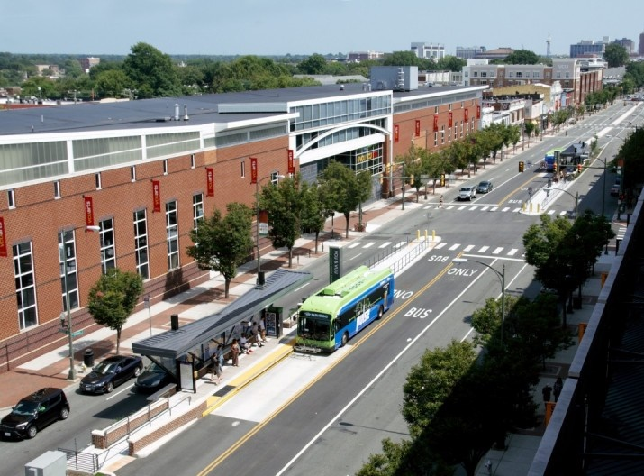
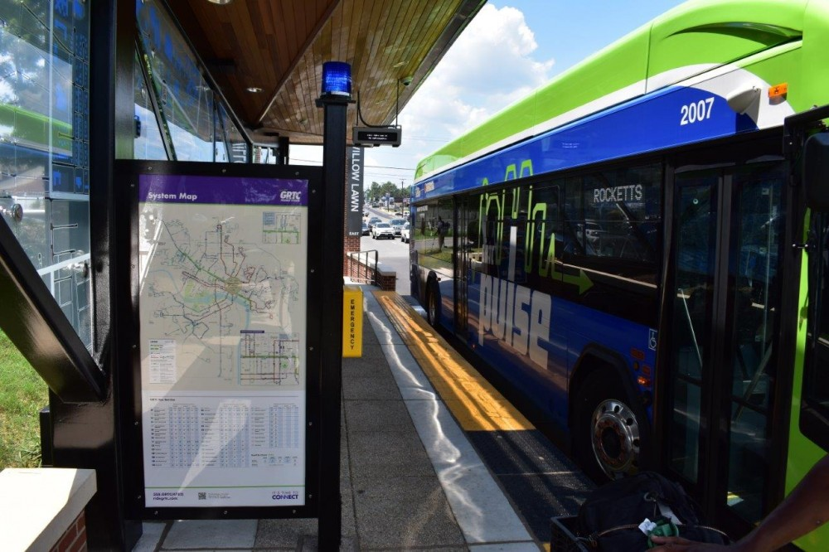
Cleveland Healthline BRT
Richmond Pulse (BRT)
Station area amenities – wayfinding, off board payment, shelter, etc.

Slide 10
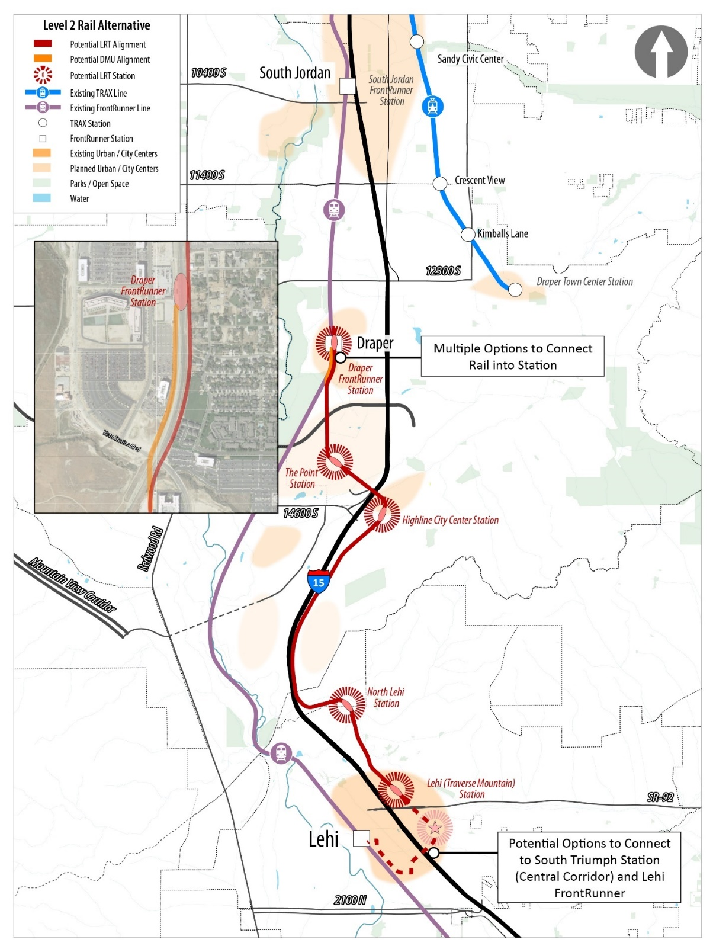
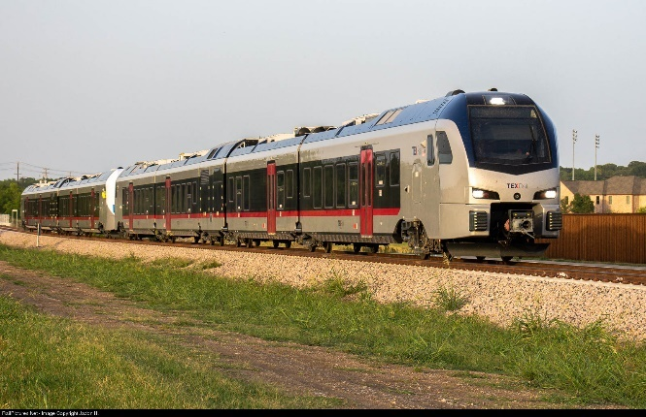
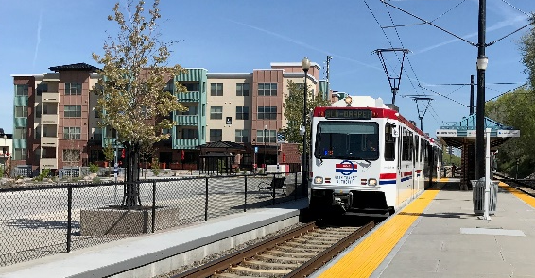
Level 2 Alternatives
-
Rail
Cleveland Healthline BRT
TEXRail DMU
Rail
Two technologies considered: Diesel Multiple Unit (DMU) and Light Rail Transit (LRT)
Nearly 95% exclusive transit operations
Enhanced station area amenities
Satellite maintenance facility
UTA TRAX LRT

Slide 11
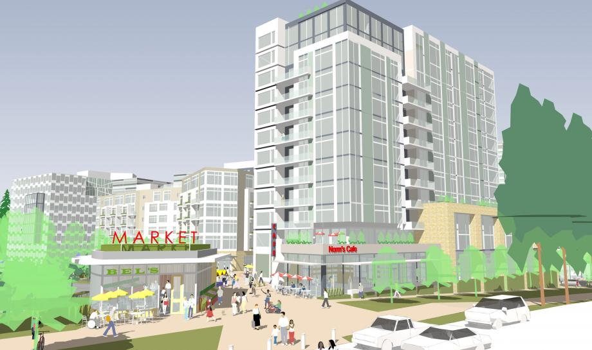
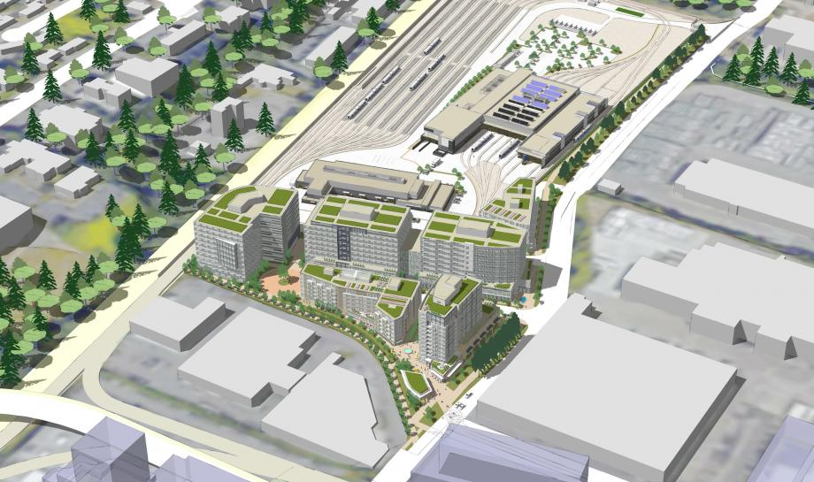
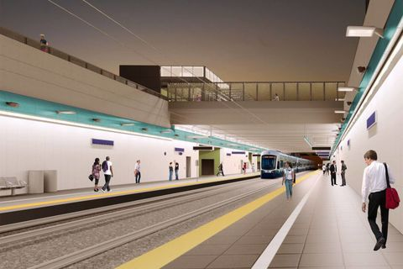
Cleveland Healthline BRT
Sound Transit East Link (LRT)
Integration with planned operations and maintenance facility
Transit integration with community planning and “green streets”

Slide 12
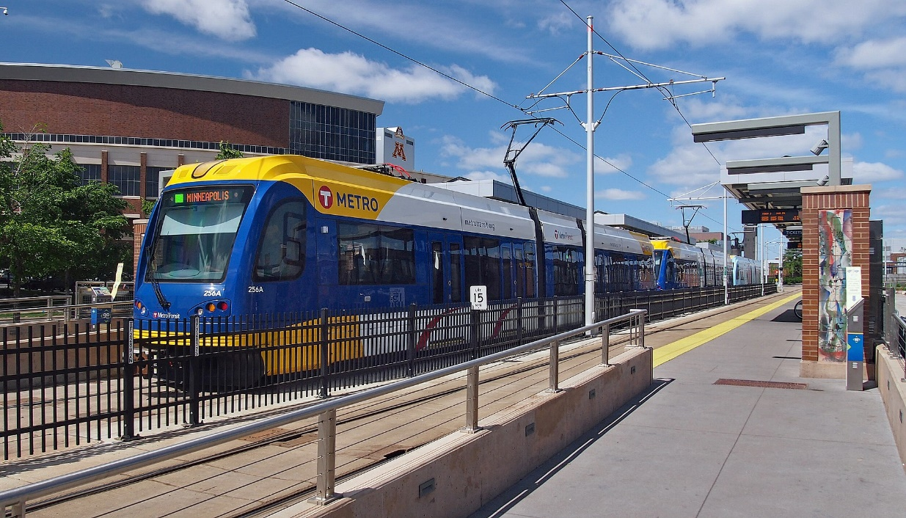
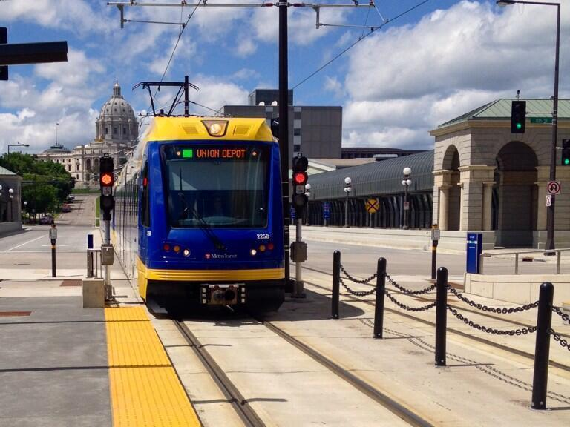
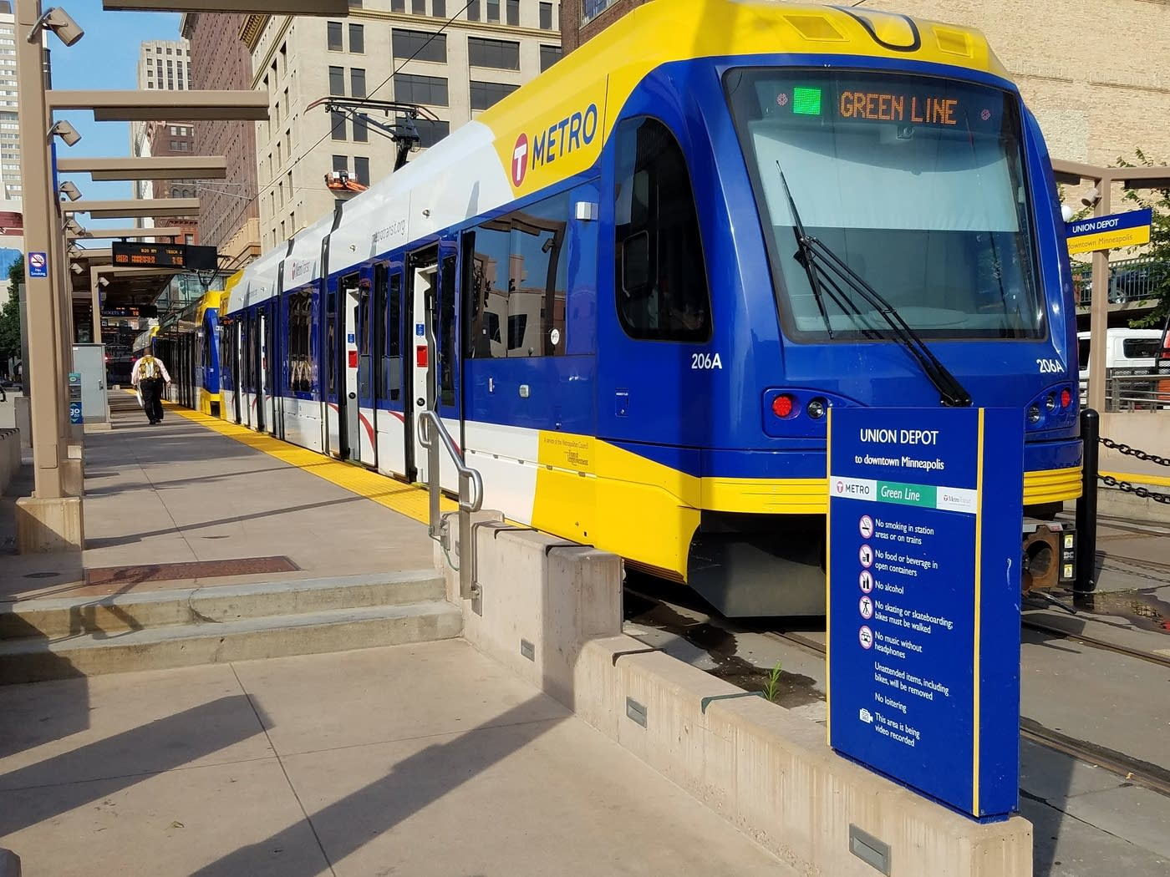
Twin Cities Green Line (LRT)
Dedicated guideway
Station area amenities
Cleveland Healthline BRT

